Slide 1


PHP Development Course
MEC Academy

Slide 2
Agenda
Control statement
If statement
If else
If elseif else
Nested if
Switch
Dependencies
&
Issues / Risks
Schedule (High Level)
Completed Activities
Timeline
Action
Items
Change Requests

Slide 3
Operations
Example:
Given a Number N corresponding to a person's age (in days). Print his age in years, months and days, followed by its respective message "years", "months", "days".
Note: consider the whole year has 365 days and 30 days per month.
Input
Only one line containing a number N (0 ≤ N ≤ 10⁶).
Output
Print the output, like the following examples.
Example:
Input
400
output
1 years 1 months 5 days

Slide 4
Operations
Example:
Given a number R calculate the area of a circle using the following formula:
Area = π * R².
Note: consider π = 3.141592653.
Input
Only one line containing the number R (1 ≤ R ≤ 100).
Output
Print the calculated area, with 9 digits after the decimal point.

Slide 5


Slide 6
Control Statements
Until now, the code is executed sequentially(line after line in order).
The control statements: special statements are used to control the execution flow of the program.
Conditional Control Statement: special statements allow the program to select between the alternatives during the program execution.
If-else Statement ,Ternary Operator; are examples for Conditional Control Statement

Slide 7
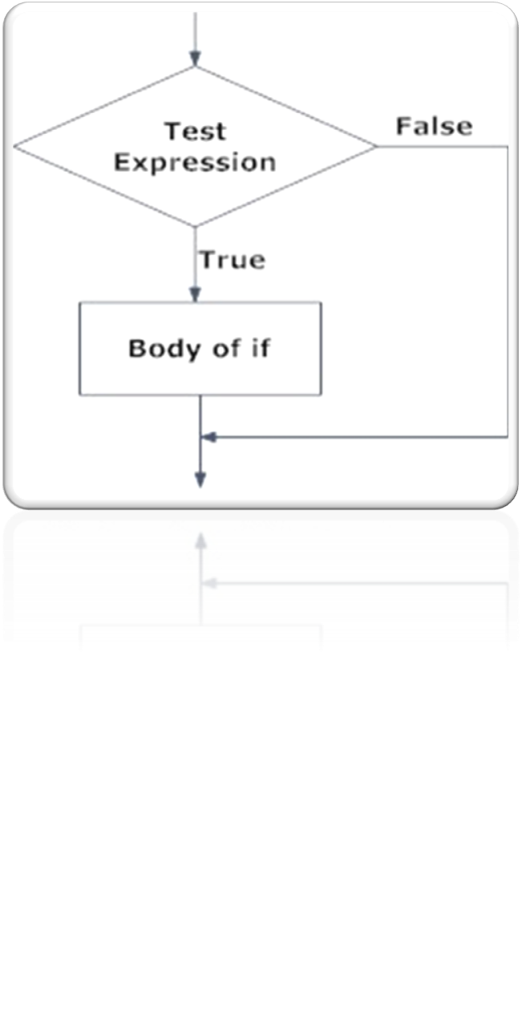
If statement
if(condition)
{ statement 1…
statement 2… }
It will go inside the block only if the condition is true otherwise, it will not execute the block.

Slide 8
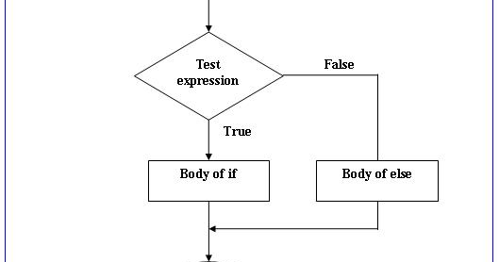
If-else Statement
if(condition){ statements (if Block) } else{ statements (Else block) }
If the condition is true then, it will execute the If block. Otherwise, it will execute the Else block.

Slide 9
If statement
Example:
Given two numbers A and B. Print "Yes" if A is greater than or equal to B. Otherwise print "No".
Input
Only one line containing two numbers A and B (0 ≤ A, B ≤ 100).
Output
Print "Yes" or "No" according to the statement.
What is ternary operator ?????
Try it !

Slide 10
If statement
Example:
Given two numbers A and B. Print "Multiples" if A is multiple of B or vice versa. Otherwise print "No Multiples".
Input
Only one line containing two numbers A, B (1 ≤ A, B ≤ 10⁶)
Output
Print the "Multiples" or "No Multiples" corresponding to the read numbers.
Try Ternary operator!

Slide 11
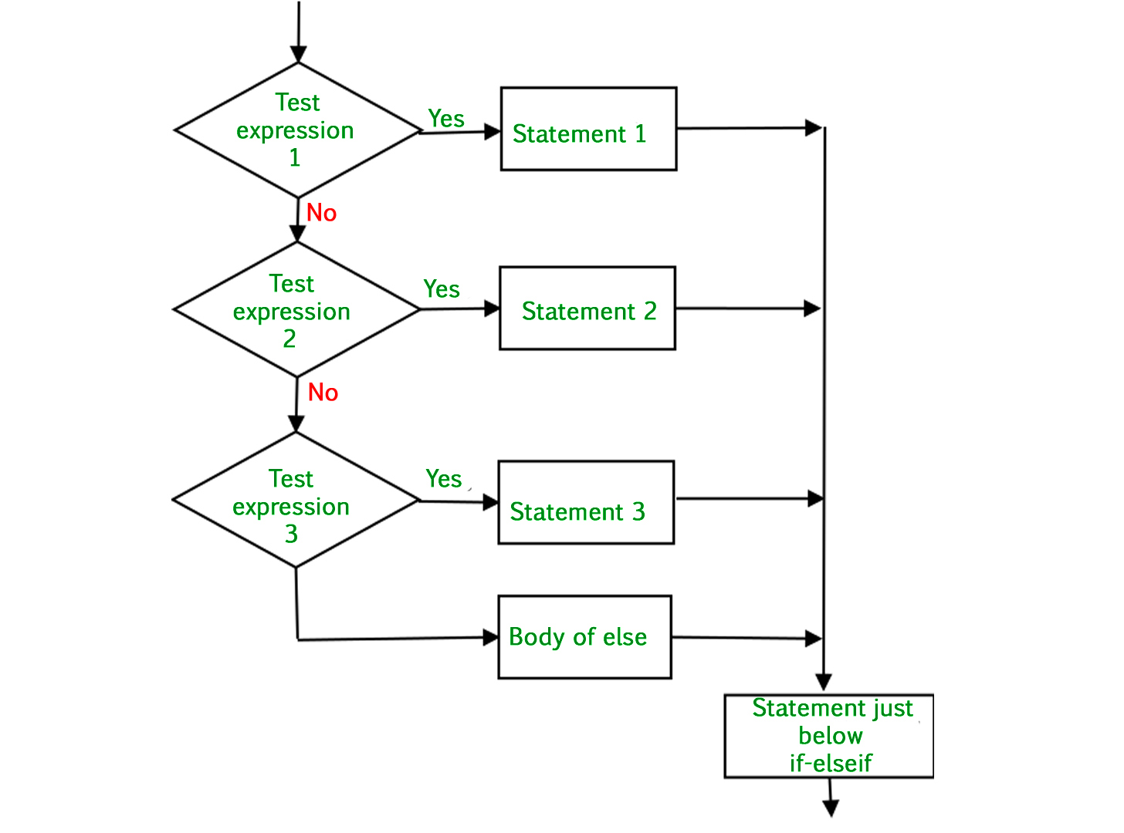
If else-If statement
if(condition)
{
statements (if Block)
}
else if(condition)
{
statements (else if block)
}
else{
statements(else Block)
}

Slide 12
If else-If statement
Example:
given 3 numbers A, B and C, Print the minimum and the maximum numbers.
Input
Only one line containing 3 numbers A, B and C ( - 10⁵ ≤ A, B, C ≤ 10⁵)
Output
Print the minimum number followed by a single space then print the maximum number.

Slide 13
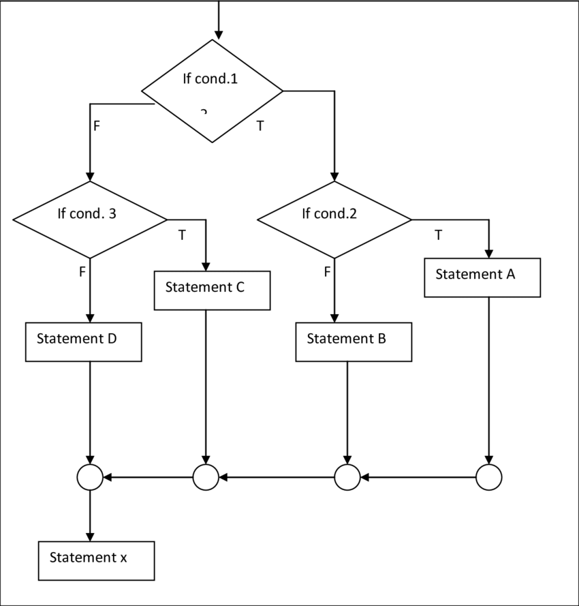
Nested if
if(condition)
{
code to be executed
if(condition){
code to be executed
}
else
}

Slide 14
Nested if
Example: ascii table
Given a letter X. Determine whether X is Digit or Alphabet and if it is Alphabet determine if it is Capital Case or Small Case.
Note:
Digits in ASCII '0' = 48,'1' = 49 ....etc
Capital letters in ASCII 'A' = 65, 'B' = 66 ....etc
Small letters in ASCII 'a' = 97,'b' = 98 ....etc
Input
Only one line containing a character X which will be a capital or small letter or digit.
Output
Print a single line contains "IS DIGIT" if X is digit otherwise, print "ALPHA" in the first line followed by a new line that contains "IS CAPITAL" if X is a capital letter and "IS SMALL" if X is a small letter.

Slide 15
Nested if
Example:
Given three numbers A, B, C. Print these numbers in ascending order followed by a blank line and then the values in the sequence as they were read.
Input
Only one line containing three numbers A, B, C ( - 10⁶ ≤ A, B, C ≤ 10⁶)
Output
Print the values in ascending order followed by a blank line and then the values in the sequence as they were read.

Slide 16
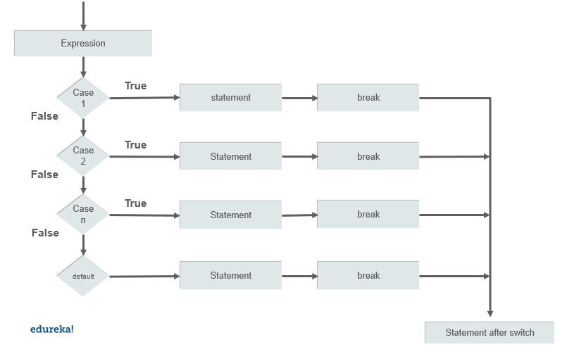
Switch
switch(expression) {
case 1:
// code block
break;
case 2:
// code block
break;
default:
// code block
}

Slide 17
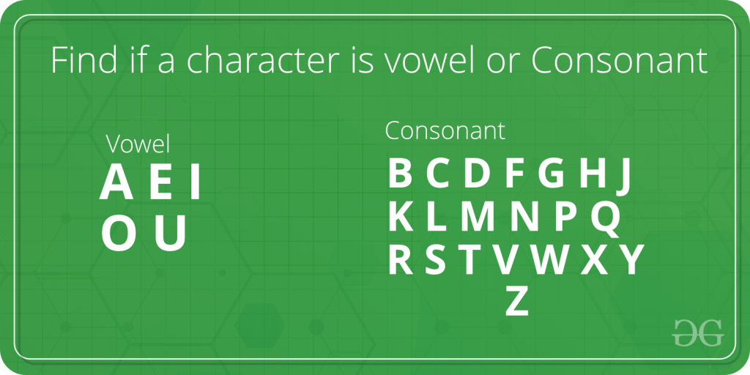
Switch
Example:
Given a character, check if it is vowel or consonant. Vowels are ‘a’, ‘e’, ‘i’, ‘o’ and ‘u’. All other characters (‘b’, ‘c’, ‘d’, ‘f’ ….) are consonants.

Slide 18
Switch
Notes
The break and default keywords are optional.
The break keyword, it breaks out of the switch block, this will stop the execution of more code and case testing inside the block.
The default keyword specifies some code to run if there is no case match.

Slide 19
THANKS
Any questions?

